Slide 1
DATABRICKS MEETUP 2025
Powering Genie Room
with Metric Views
Production-Ready Self-Service Analytics
Mohit Kathail (World Bank Group)
Nayan Sonowal(Navy Federal Credit Union)

Slide 2
What is Genie? + Our Demo Dataset: TPC-H
TPC-H: samples.tpch (built into every Databricks workspace)
1
Ask a question in plain English
ORDERS
NATION
"What is total revenue by nation in 1995?"
o_orderkey, o_custkey, o_totalprice
o_orderdate, o_orderpriority, o_orderstatus
n_nationkey, n_name, n_regionkey
2
Genie generates SQL from your data
Queries your Unity Catalog tables & Metric Views
LINEITEM
REGION
l_orderkey, l_extendedprice
l_discount, l_tax, l_returnflag
r_regionkey, r_name
3
Results returned with explanation
Validated against pre-defined benchmark questions
CUSTOMER
SUPPLIER
c_custkey, c_name
c_nationkey, c_acctbal
s_suppkey, s_name, s_nationkey
4
Iterate until 100% accuracy
Benchmarks give an objective production-readiness score
orders → lineitem | orders → customer → nation → region
Sample questions: "Revenue by nation?" | "Top customers by balance?" | "Avg discount on URGENT orders?" | "Revenue trend by quarter?"

Slide 3

The Benchmark-Driven Methodology
Measure progress objectively — never ship without a benchmark score.
1
2
3
4
5
Define
Benchmarks
Run &
Score
Diagnose
Gaps
Improve
Context
Re-run &
Verify
10–20 SME questions
with gold SQL answers
Each question is a
fresh conversation
Which questions fail
and why?
One change at a time:
metadata, SQL, text
Confirm improvement,
no regressions
↺ Repeat until 100% accuracy is achieved
How Benchmarks Work in Genie
Up to 500 benchmark questions per Genie Space
Each question runs isolated — no shared context between benchmark runs
Gold SQL per question: Genie automatically grades its own generated SQL
Test multiple phrasings (2–4 variants) of high-stakes questions
The benchmark score is what you share with stakeholders to build trust

Slide 4
I0
Iteration 0: Baseline — Raw Tables, Cryptic Columns
— → 38%
Add TPC-H tables to Genie as-is. No metadata, no descriptions, no context whatsoever.
Benchmark Score
What we added to Genie Space
✓ What Genie can answer
Tables added: orders, lineitem, customer, nation, region
✓ Nothing — 0 of 13 benchmark questions pass
No column comments, no table descriptions
✓ Genie declines to generate SQL for most questions
Default TPC-H column aliases kept (o_, l_, c_, n_, r_)
✗ Why everything fails
13 benchmark questions defined by domain SMEs before any dev
✗ "Show revenue by nation" — no column maps to "revenue"
TPC-H ▸ What Genie sees for "Show revenue by nation"
✗ "URGENT orders last month" — o_orderpriority is meaningless
SELECT ??? FROM orders WHERE ??? -- no context to build query
✗ Genie cannot guess: revenue = l_extendedprice*(1-l_discount)
-- columns: o_orderkey, o_custkey, o_totalprice, o_orderdate...
-- "revenue"→??? | "nation"→??? | "urgent"→???
💡 Poor naming blocks 100% of queries. You cannot skip foundational metadata and expect Genie to guess business meaning from technical aliases.
Next: Table Metadata
I0
I1
I2
I3
I4
I5
MV
0%
15%
38%
54%
77%
100%
100%

Slide 5
I1
Iteration 1: Table & Column Metadata in Unity Catalog
38% → 46%
Add human-readable table descriptions and column comments so Genie understands business meaning.
Benchmark Score
Changes made in Unity Catalog
✓ What now works (+15%)
Table description: "orders — each row is one customer order"
✓ "Count orders placed in 1997" — single-table query correct ✓
o_totalprice → comment: "Total order value in USD"
✓ "Average order value?" — o_totalprice understood ✓
l_discount → comment: "Discount ratio applied (0.00–0.10 scale)"
✓ "List Open status orders" — o_orderstatus mapped ✓
o_orderpriority → comment: "Urgency tier — e.g. 1-URGENT, 2-HIGH, 3-MEDIUM"
✗ What still fails
TPC-H ▸ Genie confuses join columns — all look like ID columns
✗ "Revenue by nation" — 3-table join orders→customer→nation fails
orders.o_custkey -- FK to customer.c_custkey (correct)
✗ Genie confuses o_custkey vs c_nationkey as FK candidates
orders.o_orderkey -- FK to lineitem.l_orderkey (correct)
-- Genie tries: orders.o_orderkey → customer.c_nationkey (WRONG)
✗ "Discount by region" — 4-table join produces wrong results
💡 Metadata unlocks single-table queries immediately. Multi-table joins still fail because Genie must guess join paths when foreign keys are implicit.
Next: PK/FK Keys
I0
I1
I2
I3
I4
I5
MV
0%
15%
38%
54%
77%
100%
100%

Slide 6
I2
Iteration 2: Primary & Foreign Key Constraints
46% → 54%
Explicitly define how TPC-H tables connect via Unity Catalog PK/FK relationships.
Benchmark Score
Relationships defined in Unity Catalog
✓ What now works (+23%)
orders.o_orderkey ← lineitem.l_orderkey (FK defined)
✓ "Total revenue by nation" — 3-table join correct ✓
customer.c_custkey ← orders.o_custkey (FK defined)
✓ "Top 5 customers by order value" — correct join path ✓
nation.n_nationkey ← customer.c_nationkey (FK defined)
✓ "Orders per region" — nation→region roll-up works ✓
region.r_regionkey ← nation.n_regionkey (FK defined)
✗ What still fails
TPC-H ▸ Wrong value literals Genie fabricates
✗ "Show URGENT orders" → WHERE o_orderpriority='URGENT' (wrong literal)
WHERE o_orderpriority = 'URGENT' -- actual value: '1-URGENT'
✗ "Revenue from Asia" → WHERE r_name='Asia' (actual: 'ASIA')
WHERE o_orderstatus = 'Open' -- actual value: 'O'
WHERE r_name = 'Asia' -- actual value: 'ASIA'
✗ "Fulfilled orders" → WHERE o_orderstatus='Fulfilled' (actual: 'F')
💡 PK/FK constraints eliminate join guesswork entirely. The next failure mode is categorical values — Genie fabricates plausible-sounding literals it has never seen.
Next: Value Sampling
I0
I1
I2
I3
I4
I5
MV
0%
15%
38%
54%
77%
100%
100%

Slide 7
I3
Iteration 3: Value Sampling on Categorical Columns
54% → 77%
Enable value sampling and dictionaries so Genie knows actual data values in each column.
Benchmark Score
Sampling and dictionaries enabled
✓ What now works (+16%)
o_orderpriority sampled: ['1-URGENT','2-HIGH','3-MEDIUM','4-NOT SPECIFIED','5-LOW']
✓ "Show URGENT orders" → WHERE o_orderpriority='1-URGENT' ✓
o_orderstatus dictionaries: 'O'=Open, 'F'=Fulfilled, 'P'=Processing
✓ "Revenue from ASIA" → WHERE r_name='ASIA' ✓
r_name sampled: ['AFRICA','AMERICA','ASIA','EUROPE','MIDDLE EAST']
✓ "Returned line items" → WHERE l_returnflag='R' ✓
l_returnflag dictionaries: 'N'=None, 'A'=Accepted Return, 'R'=Returned
✗ What still fails
TPC-H ▸ Wrong aggregation Genie produces for complex KPIs
✗ "Revenue per distinct customer" → COUNT(o_orderkey) not COUNT(DISTINCT o_custkey)
-- Genie: COUNT(o_orderkey) AS customer_count (WRONG)
✗ "Avg discount on high-priority orders" → wrong aggregation formula
-- Correct: COUNT(DISTINCT o_custkey) AS customer_count
-- Revenue: SUM(l_extendedprice * (1 - l_discount))
✗ Non-standard multi-measure KPIs need explicit SQL guidance
💡 Value sampling fixes all categorical filter failures at once. The remaining gap is complex KPI formulas — Genie needs gold-standard SQL examples as a reference.
Next: Example SQL
I0
I1
I2
I3
I4
I5
MV
0%
15%
38%
54%
77%
100%
100%

Slide 8
I4
Iteration 4: Example SQL for Complex KPIs
75% → 85%
Add gold-standard SQL queries as explicit references — 77% accuracy confirmed by the Databricks blog.
Benchmark Score
Example SQL queries added to Genie Space
✓ What now works — 77% accuracy
Revenue = SUM(l_extendedprice * (1 - l_discount))
✓ "Total revenue by nation?" → correct 3-table join ✓
Revenue per customer = SUM(o_totalprice) / COUNT(DISTINCT o_custkey)
✓ "Revenue per customer in EUROPE?" → DISTINCT count correct ✓
High-priority revenue: SUM with FILTER WHERE o_orderpriority='1-URGENT'
✓ "High-priority order share?" → FILTER clause used correctly ✓
Avg discount by nation: 3-table join orders → customer → nation
✗ What still fails — 23% gap
TPC-H ▸ Gold SQL example added for revenue by nation
✗ "Last quarter revenue" → uses calendar quarter not date range
SELECT n.n_name, SUM(l.l_extendedprice*(1-l.l_discount)) AS revenue
✗ "Revenue from ASIA region" → nation→region 4-table join missed
FROM orders o JOIN lineitem l ON o.o_orderkey=l.l_orderkey
JOIN customer c ON o.o_custkey=c.c_custkey JOIN nation n ON c.c_nationkey=n.n_nationkey
✗ "Discount as a percentage" → returns 0.085 instead of 8.5%
💡 77% is the largest single jump — Example SQL is the biggest lever for complex KPIs. The final 23% is domain rules and date semantics, not SQL structure.
Next: Instructions
I0
I1
I2
I3
I4
I5
MV
0%
15%
38%
54%
77%
100%
100%

Slide 9
I5
Iteration 5: Text Instructions for Edge Cases
85% → 93%
Add Genie space instructions for date semantics, region roll-ups, unit formatting — 100% confirmed by blog.
Benchmark Score
Instructions added to Genie Space knowledge store
✓ 93% benchmark accuracy achieved!
"Use o_orderdate for all date-related questions"
✓ "Last quarter revenue" → correct 90-day o_orderdate range ✓
"'Recent' = last 365 days. 'Last year' = previous full calendar year"
✓ "Revenue from ASIA region" → 4-table join via region ✓
"Region roll-up: join nation→region via n.n_regionkey=r.r_regionkey"
✓ "Average discount rate?" → 8.5% (not 0.085) ✓
"l_discount and l_tax are ratios (0–0.10); show as % by multiplying ×100"
✗ New problem: context stack is complex
TPC-H ▸ Instructions that closed the final 23% gap
✗ 5 tables + column comments + FK constraints = large Genie context
"recent" → o_orderdate >= CURRENT_DATE - INTERVAL 365 DAYS
✗ 8 SQL examples + text instructions = growing maintenance burden
"by region" → JOIN nation n ON c.c_nationkey=n.n_nationkey
JOIN region r ON n.n_regionkey=r.r_regionkey
✗ Every new KPI requires a new SQL example — does not scale
💡 100% achieved — confirmed by Databricks blog. But the context stack is now complex and brittle. This is the exact problem Metric Views were built to solve.
Next: Metric View →
I0
I1
I2
I3
I4
I5
MV
0%
15%
38%
54%
77%
100%
100%

Slide 10
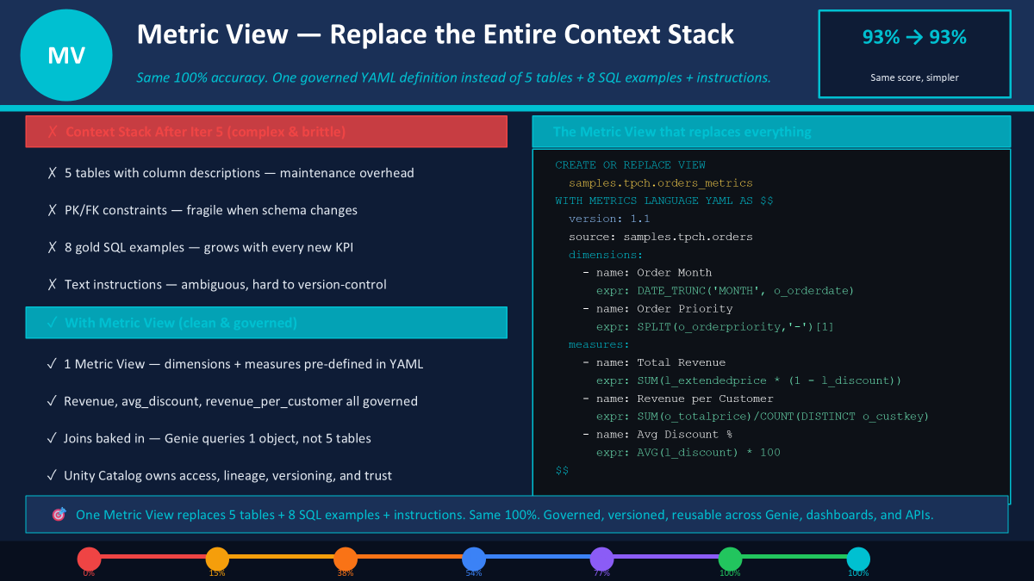
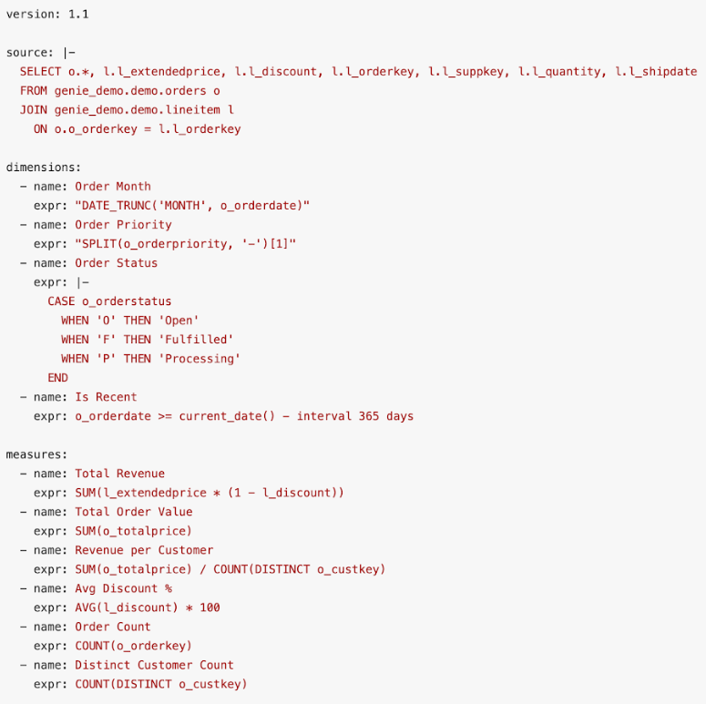

Slide 11






Best Practices for Production-Ready Genie Spaces
Lessons from the 6-iteration journey — ordered by impact
★
⭐ #1 BEST PRACTICE: Use Metric Views as your primary Genie context
⭐ Metric Views
Top Priority
A single Metric View replaces tables + SQL examples + instructions in one governed YAML. Highest ROI for accuracy, consistency & maintainability.
Start with Metadata First
Add Example SQL for KPIs
Unity Catalog descriptions are foundational. Invest in table comments and column names before anything else — poor naming blocks every query.
Gold-standard queries for complex aggregations are the single biggest accuracy lift. Model your domain KPIs explicitly — don't expect Genie to guess.
Define PK/FK Relationships
Use Text Instructions Last
Explicit foreign keys eliminate join guesswork. Without them, Genie picks wrong join columns across tables with similar-sounding names.
Instructions handle edge cases (date semantics, unit formatting) but are brittle. Prefer structured context: Metric Views > SQL examples > instructions.
Enable Value Sampling
Benchmark Before You Ship
Sample categorical columns (order status, priority, region) so Genie uses real data literals, not plausible-sounding fabrications.
Run the full benchmark suite after every change. Share the score with stakeholders — an objective number builds more trust than any demo.
⭐ Metric Views
→ SQL Expressions
→ Example SQL
→ Value Dicts
→ Instructions

Slide 12
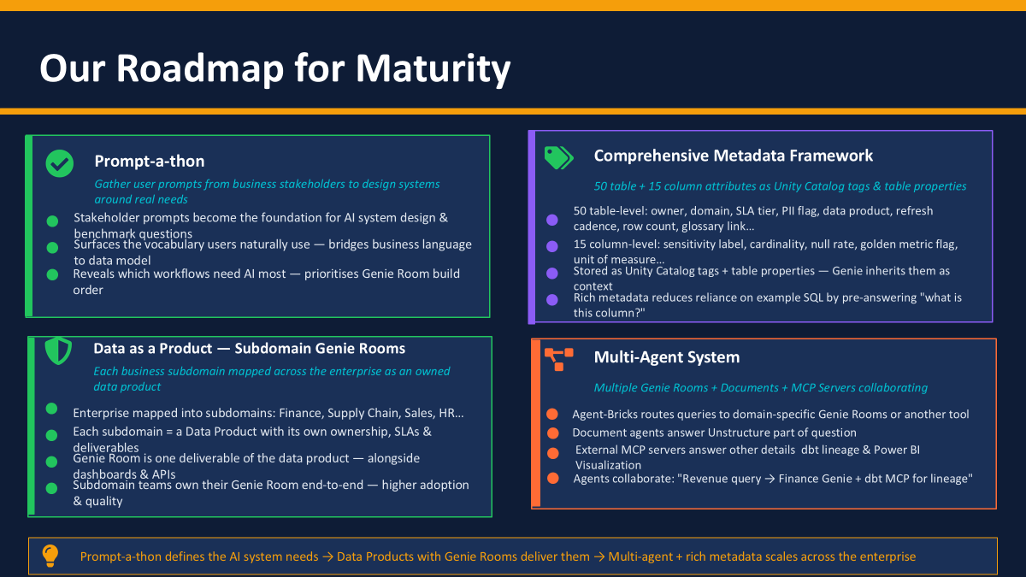

Slide 13
Current Limitations & What's Coming
Metric Views are in Public Preview — know the gaps before you build.
CURRENT LIMITATIONS
ON THE ROADMAP
✗
Single fact table only —
→
Power BI native integration
BETA
One source per metric view. Multiple facts require separate views or pre-joined SQL.
Microsoft + Databricks working on MEASURE() support. Tabular Editor Semantic Bridge available now.
→
dbt-databricks native support
In-Progress
✗
No Delta Sharing or data profiling —
Open feature request for metric_view as first-class materialization type in dbt-databricks.
Cannot be shared via Delta Sharing. Catalog Explorer profiling also unsupported.
→
Low-code Metric View authoring
Coming Soon
✗
Many-to-many joins unsupported —
Drag-and-drop editor — no YAML required. Announced in the Oct 2025 roadmap.
Joins must be many-to-one. SCD2/calendar joins collapse and return wrong counts.
→
Tableau native integration
Planned
✗
Requires Runtime 17.2+ / SQL 2025.30 —
Tableau signalled plans for native Metric View support. Currently works via standard SQL.
v1.1 semantic metadata needs Preview channel warehouse. Older runtimes lack full support.
→
Materialization GA
Experimental
Pre-computed aggregations via Lakeflow Pipelines — currently Experimental.
→
Window measures GA
Experimental
Rolling averages, cumulative totals, period-over-period — currently Experimental.

